Slide 1
Agenda
Hardware
Protection
in OS

Slide 2
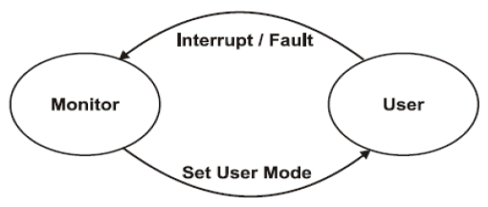
Dual-mode operation
Main Point:- All protection issues are uses to ensure that proper, fair and effective use of all resource to the process.
Sharing system resource requires OS to ensure that an incorrect program cannot cause other program to execute incorrectly.
In order to support protection, two modes of operation are provided, namely user mode and system mode.
In User mode the program execution is done on behalf of a user.
In System mode it also called supervisor mode, here execution is done on behalf of OS itself. It allows those programs that are not allowed in user mode.
Solution: The mode bit is added in computer H/W to indicate the current mode
i.e., system=1 or user mode=0. Privileged instruction can be issued only in monitor mode.

Slide 3
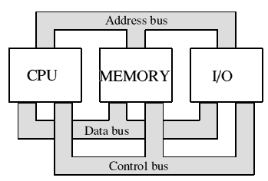
Hardware in Computer System
CPU
MEM
I/O

Slide 4
CPU protection
CPU protection is referred to as we can not give CPU to a process forever, it should be for some limited time otherwise other processes will not get the chance to execute the process
To prevent the user program getting stuck in an infinite loop and never returning control to OS uses the timer. After certain time, an interrupt occurs. Before turning control to user, OS loads up the timer to interrupt. Once the timer interrupt occurs, control goes back to OS.
At this point OS may send out a fatal error message or may increase the timer limit.
It is used in time sharing environments.
In order to protect a, timer is provided.
Timer is decremented at every clock tick.
The period may be fixed or variable.
When timer reaches to zero then interrupt occurs.
Fixed clock interval is required to allow the access of CPU to process.
It also should ensure that CPU does not assigned infinite time to any process otherwise single process may get large time span.
Load timer is a privileged instruction.

Slide 5
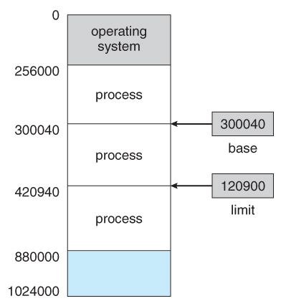
Memory protection
Memory protection is a way to control memory access rights on a computer, and is a part of most modern instruction set architectures and operating systems.
The main purpose of memory protection is to prevent a process from accessing memory that has not been allocated to it.
Usually process resides in address space which should have fix boundary so that the content of process can't interleave with other process contents.
In order to provide protection to memory location the range is provided to the register to determine address space.
In figure the job2 have boundaries with base and limit register value.
(i) Base Register: It hold the smallest legal physical address.
(ii) Limit Register: It consists of size of the range (max address).
Facts:-
Memory outside the defined range is protected.
No process can access the contents outside their address space.
The address space should not less than base register and should not greater than limit register.

Slide 6
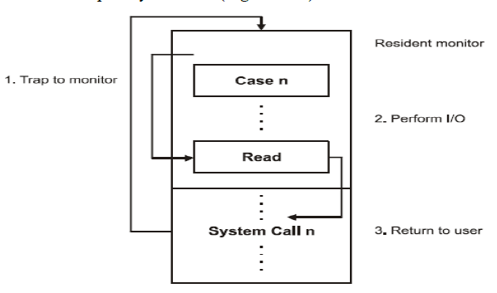
I/O protection
To prevent users from performing illegal I/O, All I/O instructions are privileged instruction; they must ensure that a user program could never gain control of the computer in monitor mode.
If user wants to take privilege, it needs to switch with the help of System call
When a corresponding trap or interrupt occurred, the hardware would switch to monitor mode, and would transfer control through the (modified) interrupt vector to the user program
I/O protection is required in system for the situation not to occurred in the system:
Termination I/O of other process
View I/O of other process
Giving priority to a particular process I/O

Slide 7
Thank You
We will meet Soon!!!!!!!!!!

